Slide 1
Mortgage Loan Application Data Exploratory Analysis
Finding meaning and importance within Mortgage Loan Application Dataset

Slide 2
Introductory Story
A client wishes to buy a home, but they do not have full cash-in-hand. So the client must apply for a mortgage loan. They proceed to tell the bank all their financial matters and the home that they wish to purchase. Once the bank makes its decision to approve the loan, the client will sign all necessary papers to close the deal. This is called Loan Origination.

Slide 3
Understanding data by Top Categories
The data can be grouped into 5 major categories:
Loan
Applicant Information
Property Type
Location
Lender Information

Slide 4
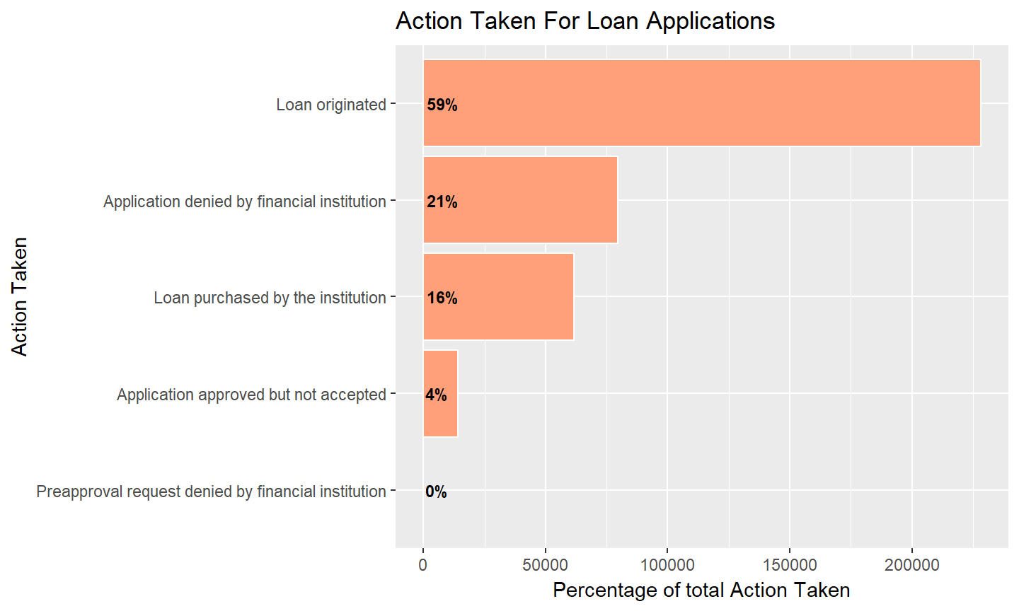
1. Loan Category
Responses to loan applications.
59% of loans have “originated”.

Slide 5
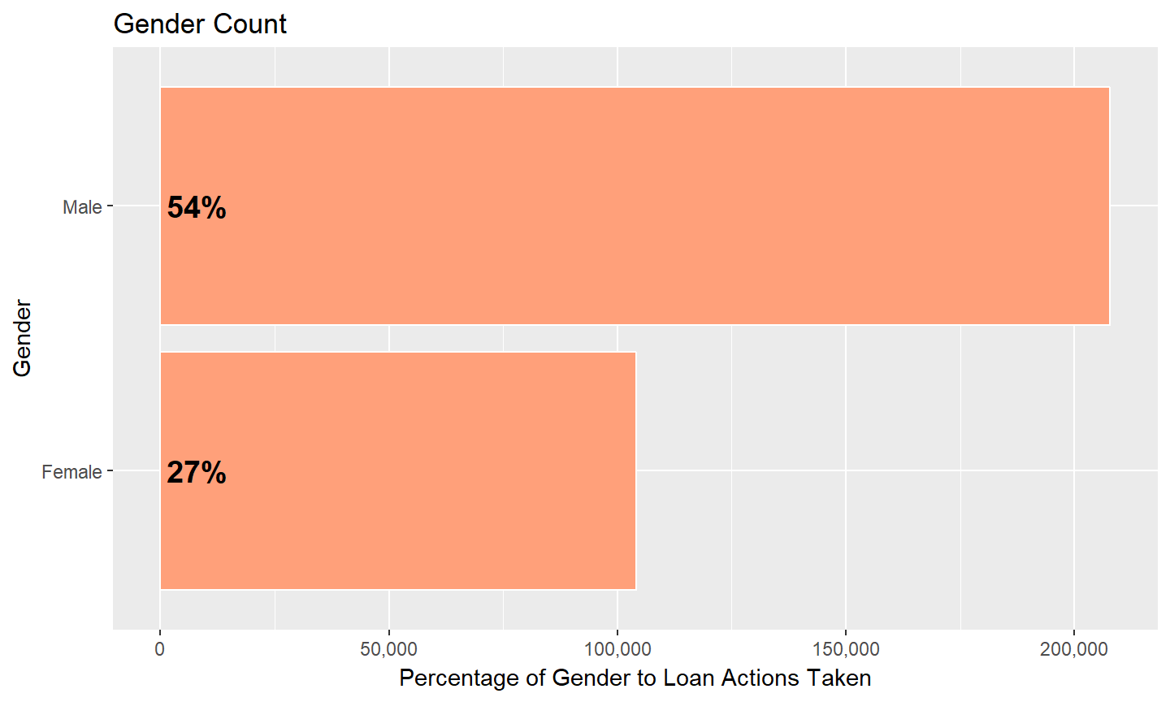
2. Applicants
Male close to double rate of
applicants than their counterpart

Slide 6
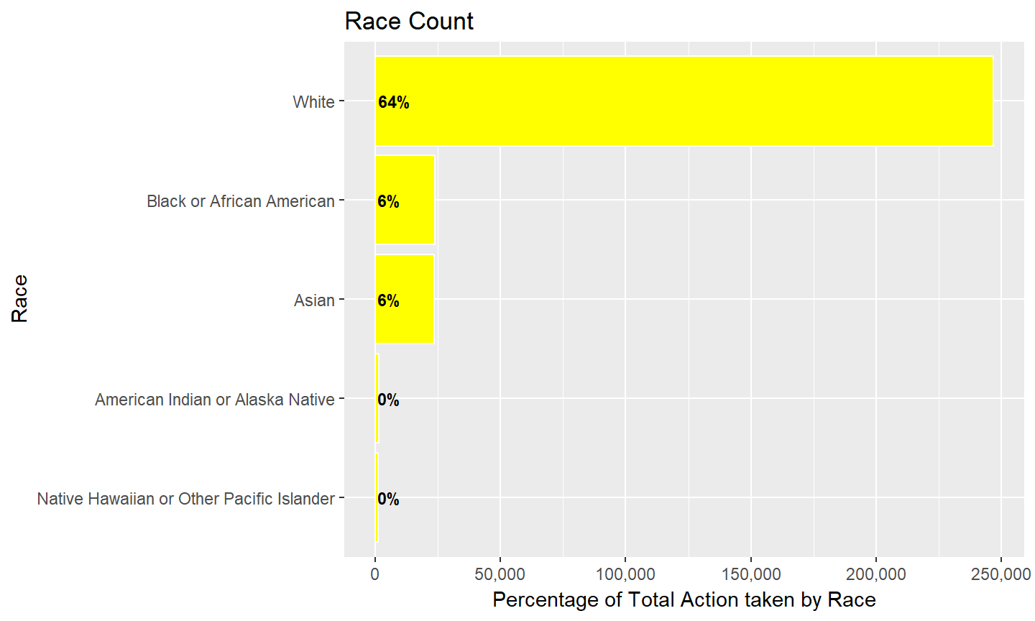
3. Race
Majority of the loan applicants
are “White” in NY.

Slide 7
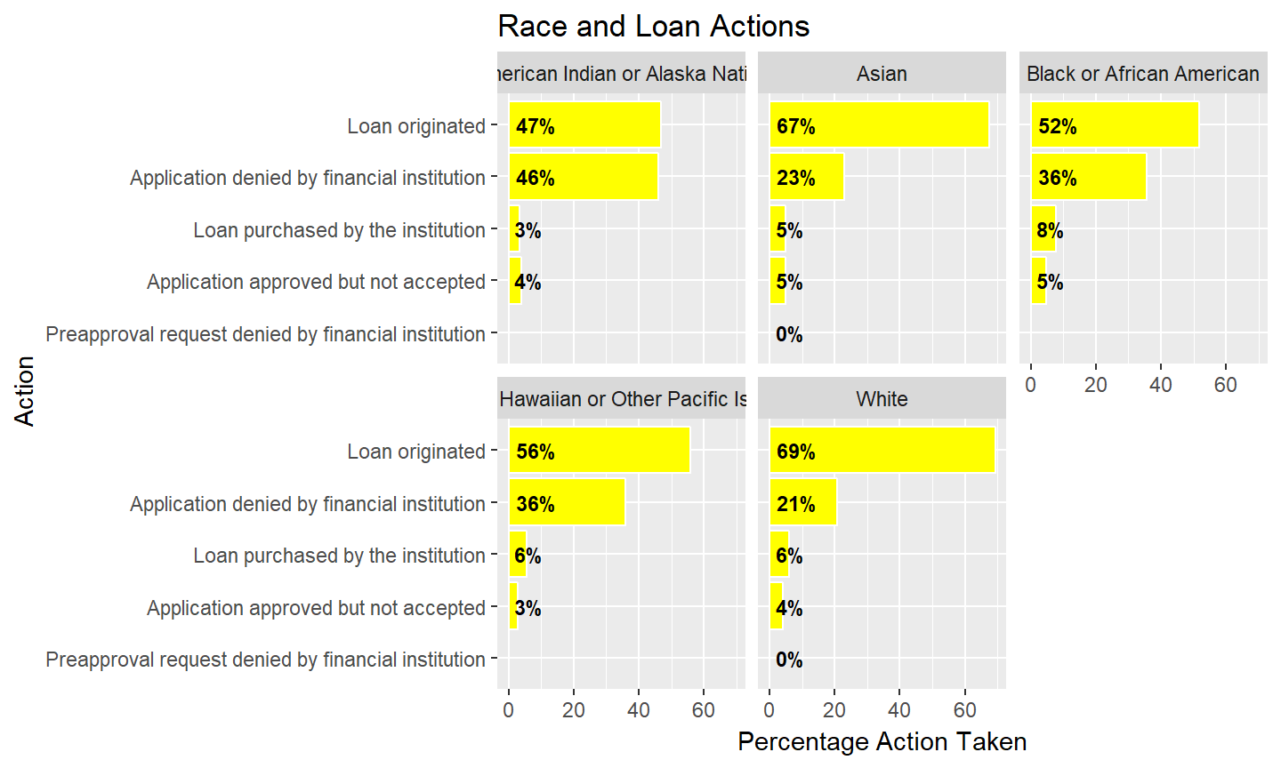
4. Actions taken based on Race
White/Asians are ~68% loan originated
while other race are much lower
with higher denial rate.

Slide 8
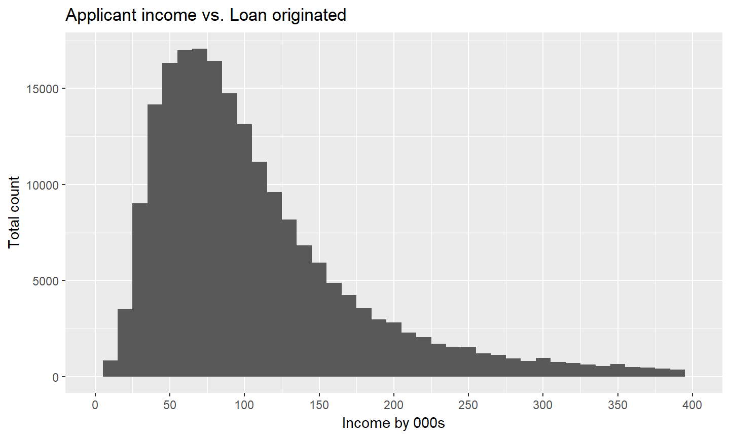
5. Loan Origination based on Income
Highest Loan Originated is from
income of 55K-75K

Slide 9
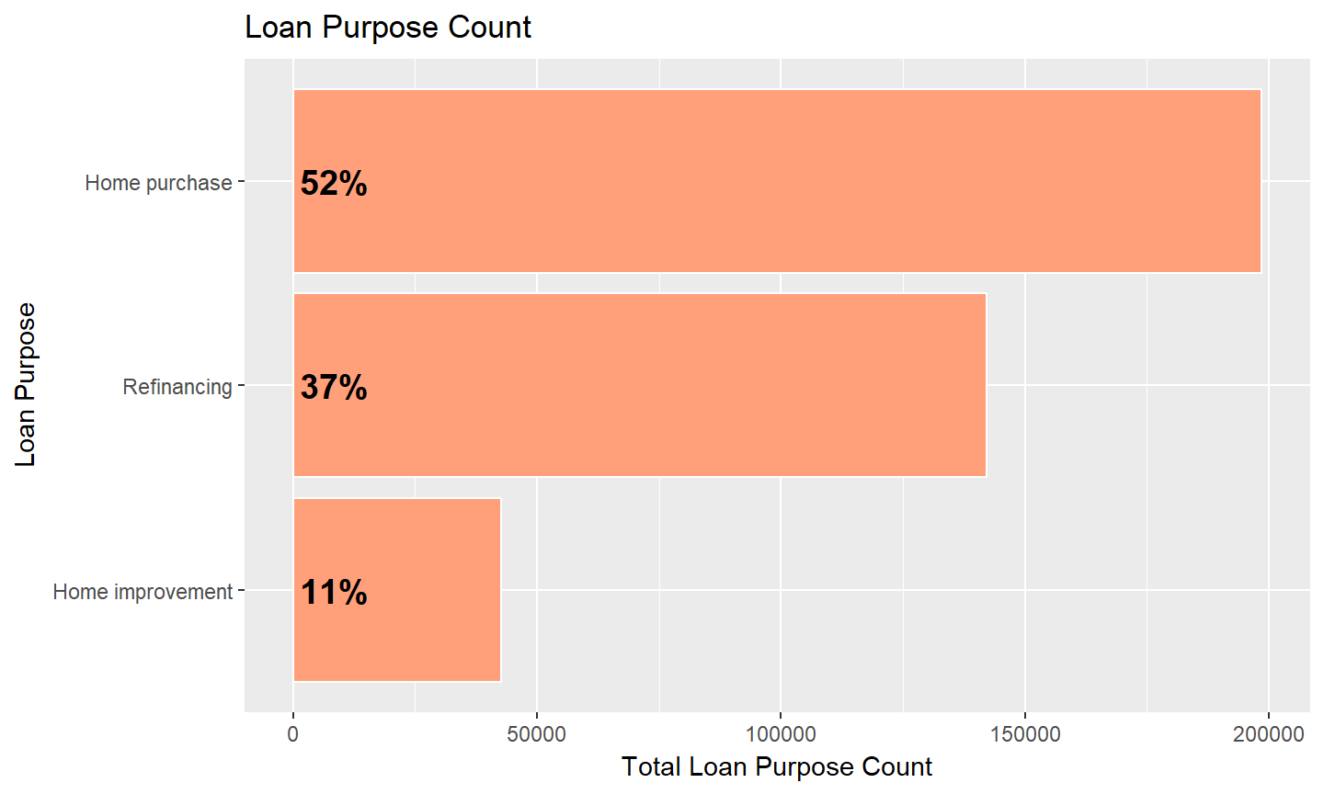
6. Loan Purpose Types
3 types of loan purpose(desc.)
Home Purchase
Home Refinancing
Home Improvement

Slide 10
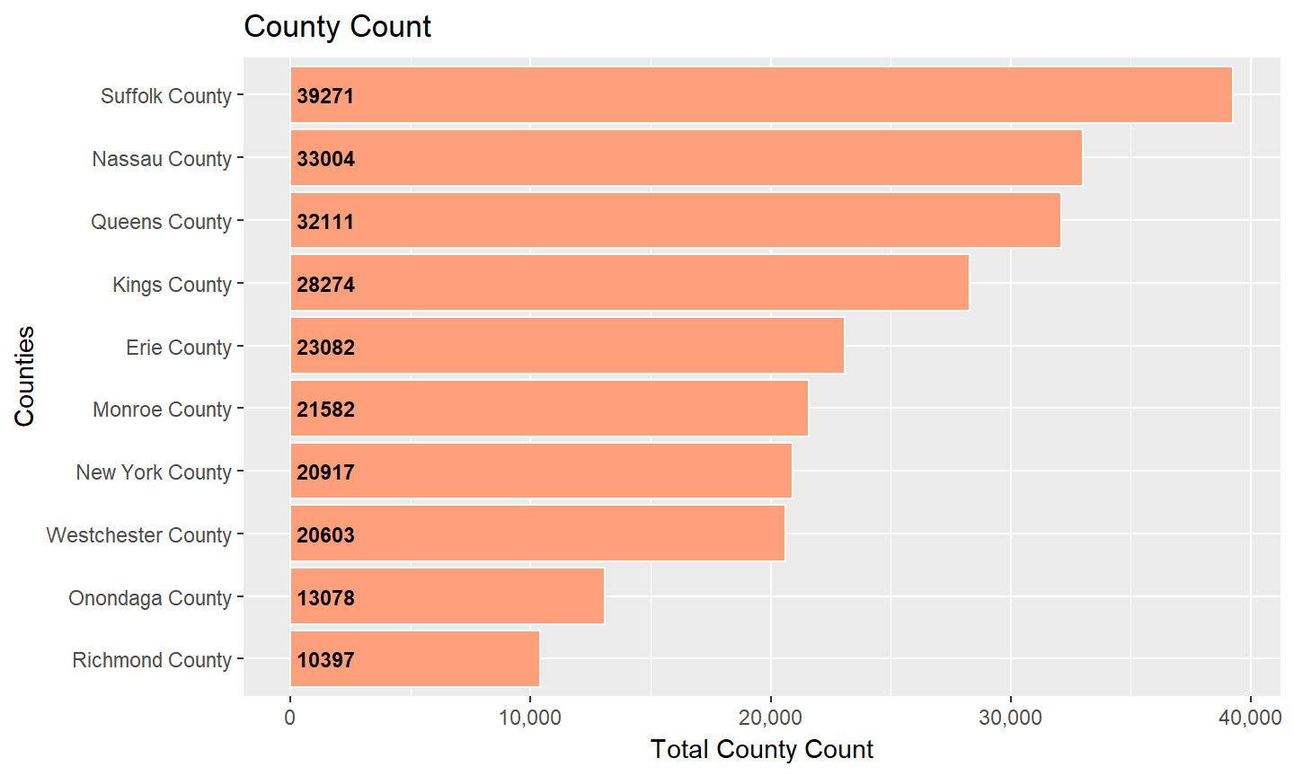
7. Top 10 counties with Loan Origination
7 of 10 counties are within
New York City area

Slide 11
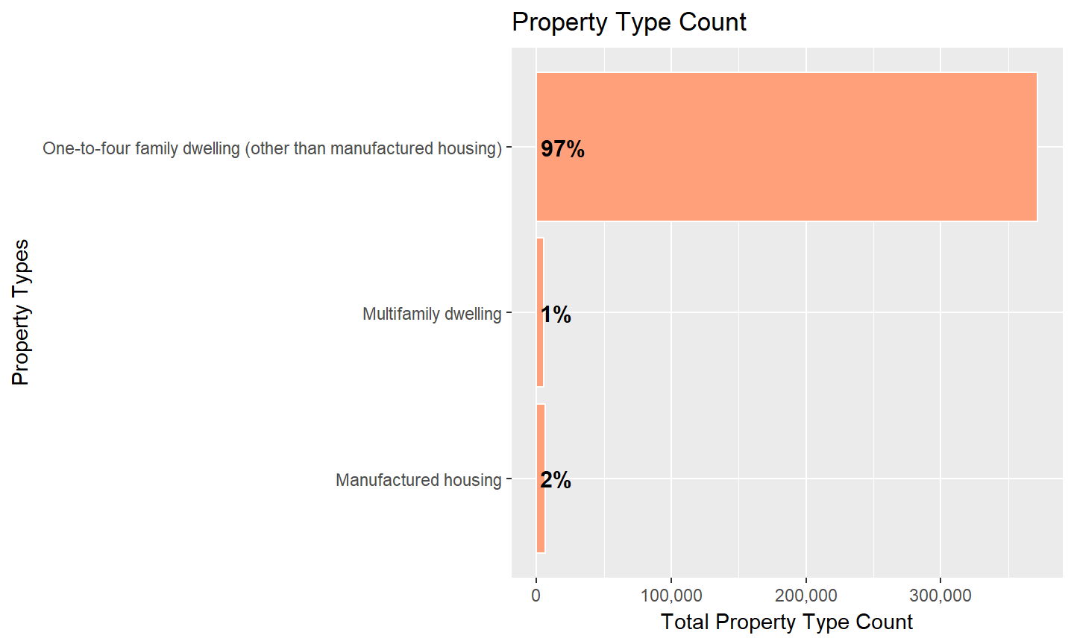
8. Property Types for Loan Applied
High rate of application for
single family dwelling

Slide 12
9. Predictive Modeling Categories
Selected Data for predictive modeling
Action Taken
Applicant Ethnicity
Applicant Income in 000s
Applicant Race
Co-applicant ethnicity/sex
County
Hoepa Status
Lien Status
Loan Purpose
Loan Types
MSAMD
Owner Occupancy
Preapproval
Property Type
Purchaser Type
Loan amount

Slide 13
10. Logistic Regression Model
Based on the logit model we summarise
## Min. 1st Qu. Median Mean 3rd Qu. Max.
## 0.0000 0.3781 0.6787 0.6435 1.0000 1.0000
With an accuracy of:
83.77%

Slide 14
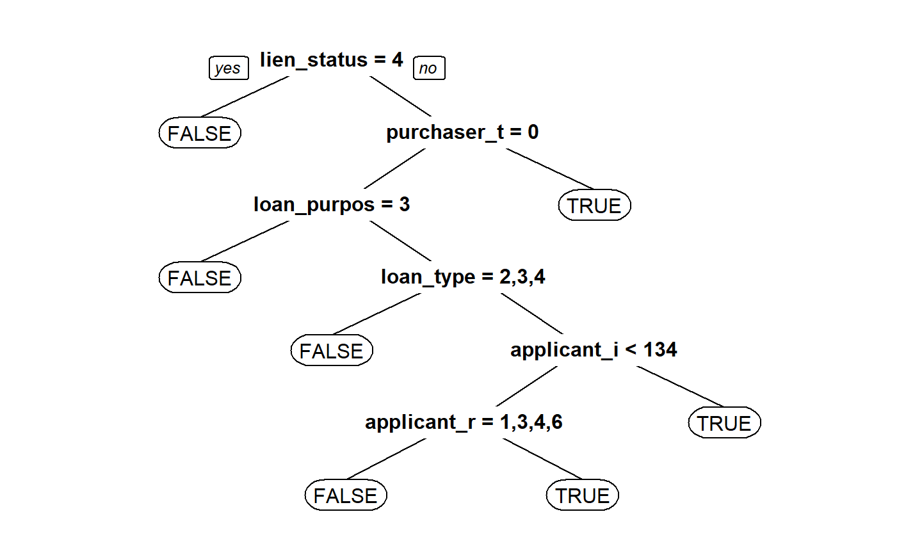
11. CART Predictive Model
The priority of importance
based on decision tree:
Lien Status
Purchaser Type
Loan Purpose
Loan Type
Applicant Income
Applicant Race

Slide 15
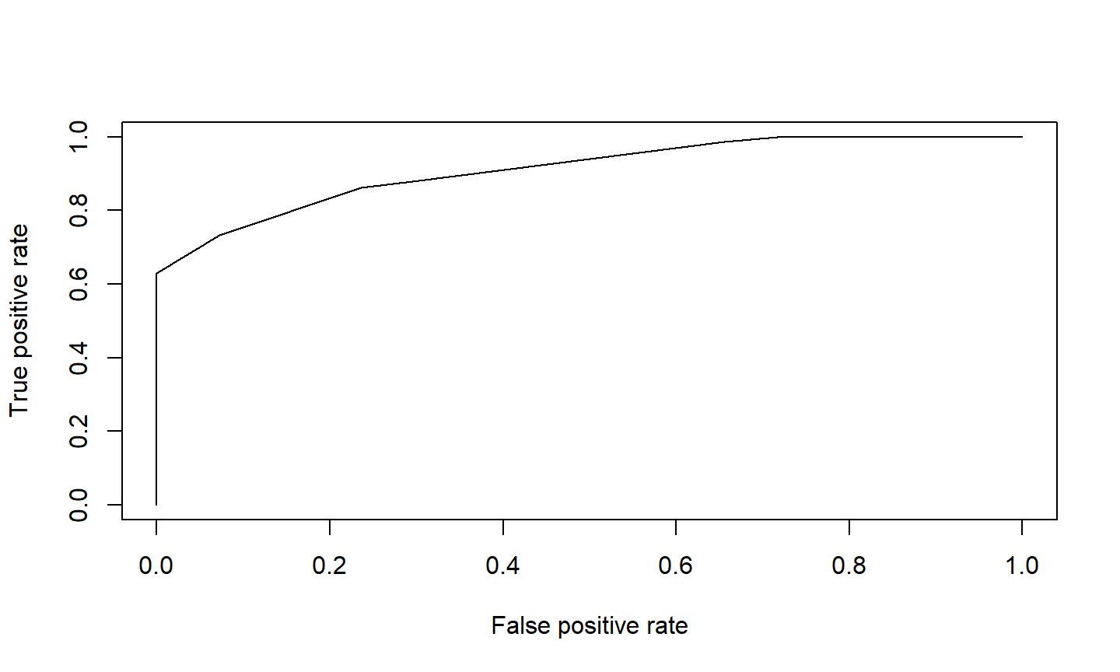
12. ROC Curve and AUC Calculation
The AUC calculation based
on the ROC Curve:
91.17%

Slide 16
Logistic Regression VS Decision Tree
Logistic Regression feels much more closer to a linear dimension, where you pit dependent variable against the listed independent variables.
Decision Tree seems to calculate as a “big picture”, where you take the prediction into a multiple dimension, able to create a much clearer priority list, then pit the list against the next priority variable.

